Slide 1
Numeracy for Language Models: Evaluating and Improving their Ability to Predict Numbers
Georgios P. Spithourakis, Sebastian Riedel
ACL 18
19.06.05
Doyeon Lim

Slide 2
Research Motivation
Problem in existing Language Model
Numerical Value Characteristic: Countinuous
➔ Out of Vocabulary
Treating the number as token leads out of vocabulary

Slide 3
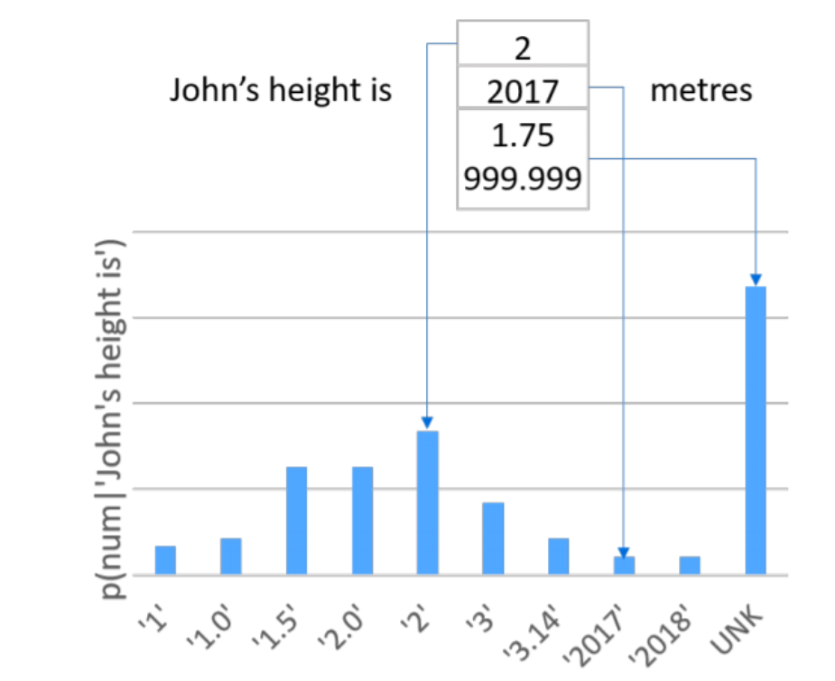
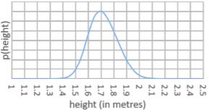
Research Motivation
Problem in existing Language Model
Numerical Value Characteristic:
has specific range per attribute
Concept of size exist

Slide 4
Research Contribution
Three different strategies for modelling numerals
Propose the use of evaluations that adjust for the high out-of-vocabulary rate of numerals
evaluate on a clinical and a scientific corpus and provide a qualitative analysis of learnt representations and model predictions

Slide 5
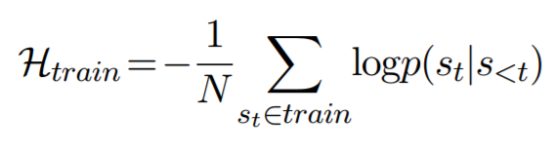
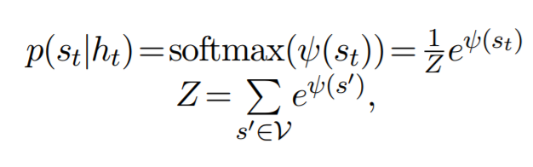
Language Model
> Language Model guess next word using previous words
Minimize cross entrophy
Scoring function

Slide 6

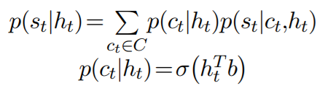

Strategies for Modelling Numerals 1. Hierarchical Softmax
Divide the class as ‘word’ and ‘number’ and learn distribution of each class
➔ Still have out of vocabulary problem but treat ‘literal’ and ‘numeral’ differently
2 more ways to calculate

Slide 7

Strategies for Modelling Numerals 2. Digit-RNN Model
Like character-level embedding, generate digit-level embedding → Can deal with open numbers

Slide 8
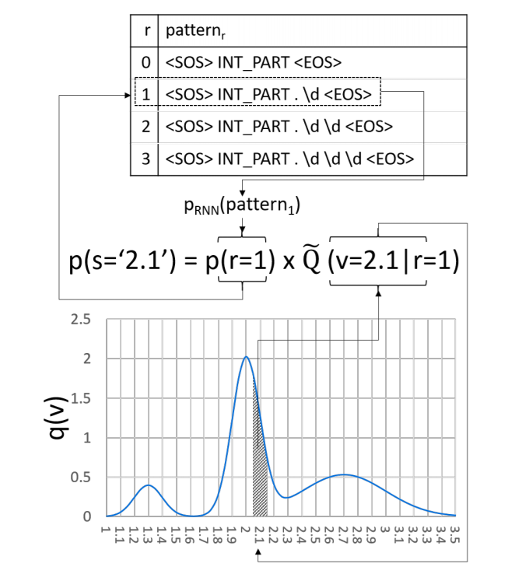
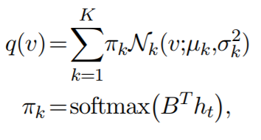
Strategies for Modelling Numerals 3. Mixture of Gaussians Mode
Guess gaussian mixture model when hidden state is given
Gaussian Mixture Model predict the number distribution.
Gaussian Mixture Model is suitable for continuous space

Slide 9
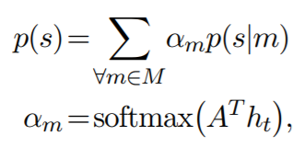
Strategies for Modelling Numerals 4. Combination Model
M = {h-softmax, d-RNN, MoG}
Combination model: Weighted sum of each model

Slide 10
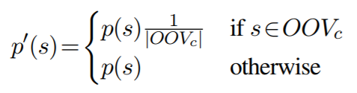
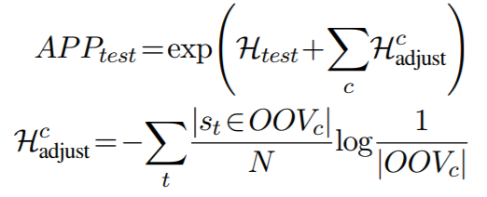
Evaluation Metric 1 - Perplexity Evaluation
Modification of Perplexity Evaluation in Language Model
→ Modify the score to fit in numeral value which has lots of out of vocabulary

Slide 11
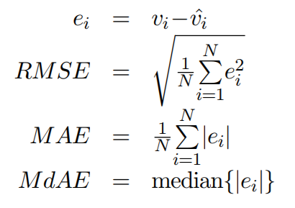
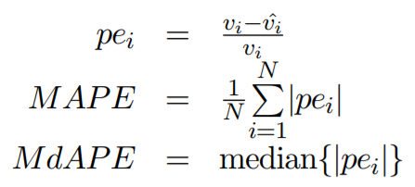
Evaluation Metric 2 – Numerical value evaluation

Slide 12
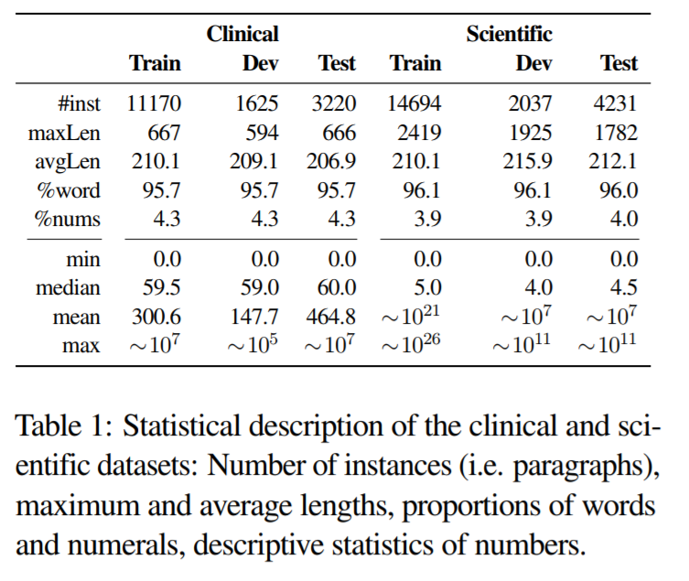
Data

Slide 13
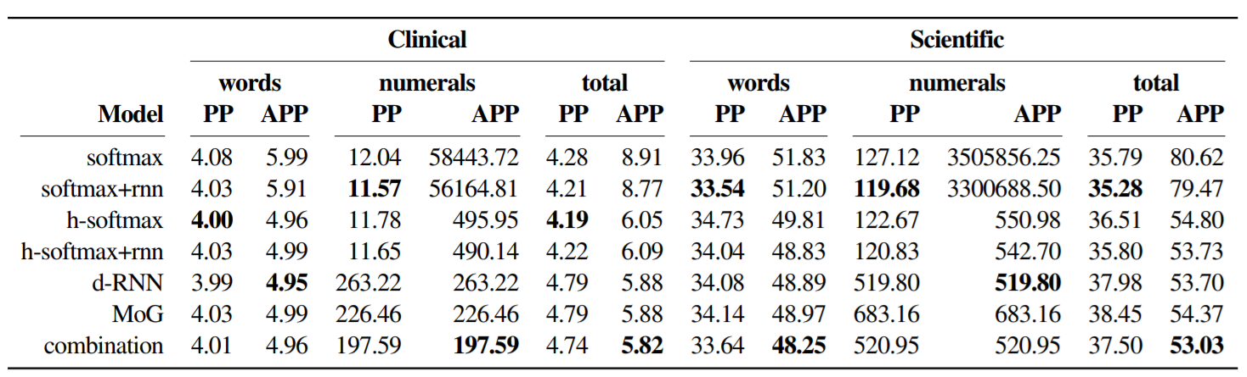
Experimental Results and Discussion

Slide 14
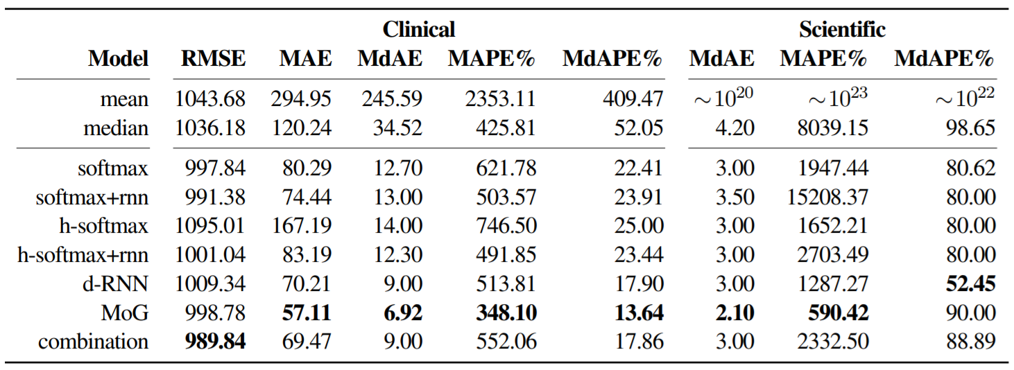
Experimental Results and Discussion

Slide 15
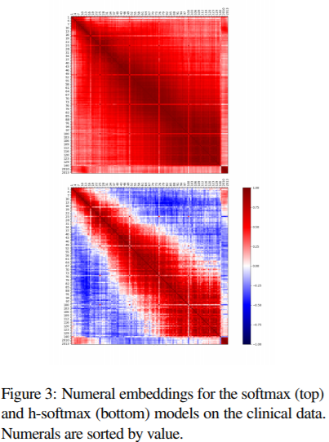
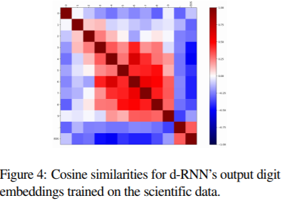
Quantitative Results

Slide 16
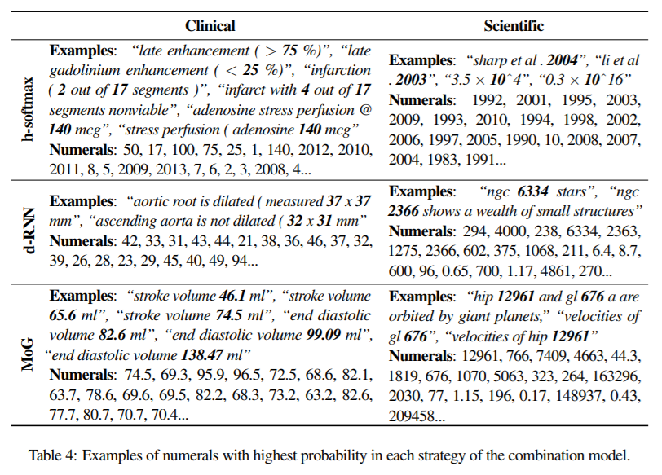
Quantitative Results

Slide 17
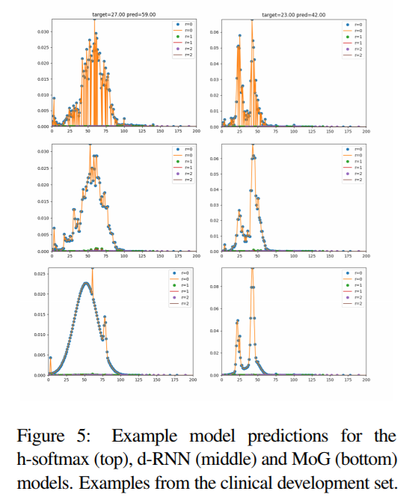
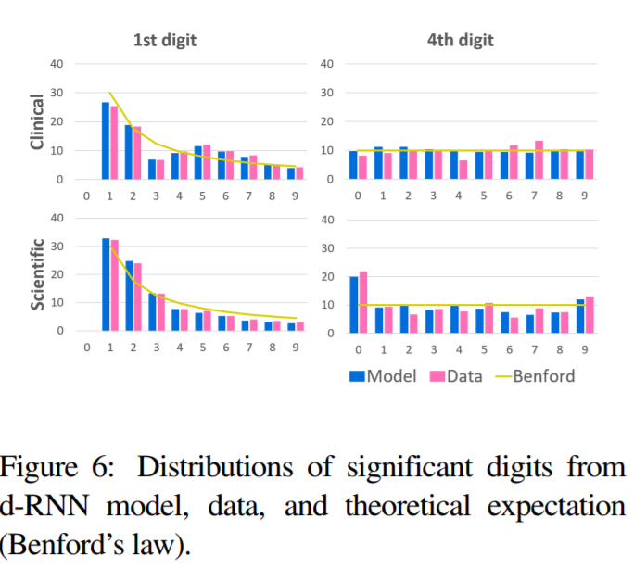
Quantitative Results

